Slide 1
SIR Model – With Day 100 Trigger

Slide 2
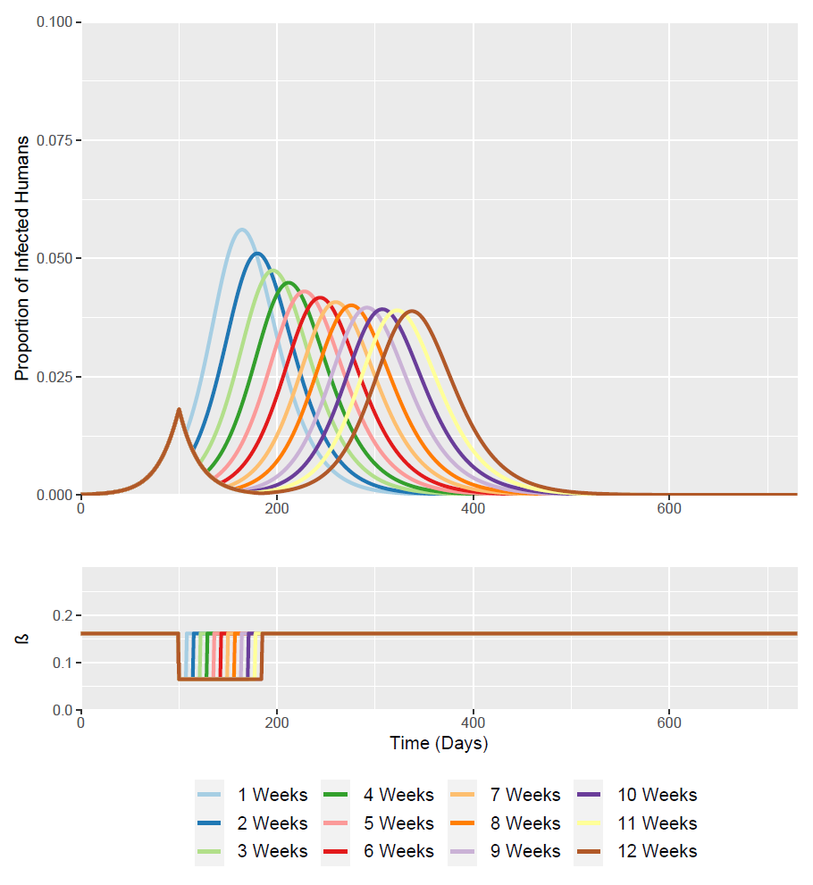
Time of Intervention Trigger =
100 Days (Week ~14.2)
Optimised timing for the two 12 week intervention scenario
I(t = 100) = 0.0182

Slide 3
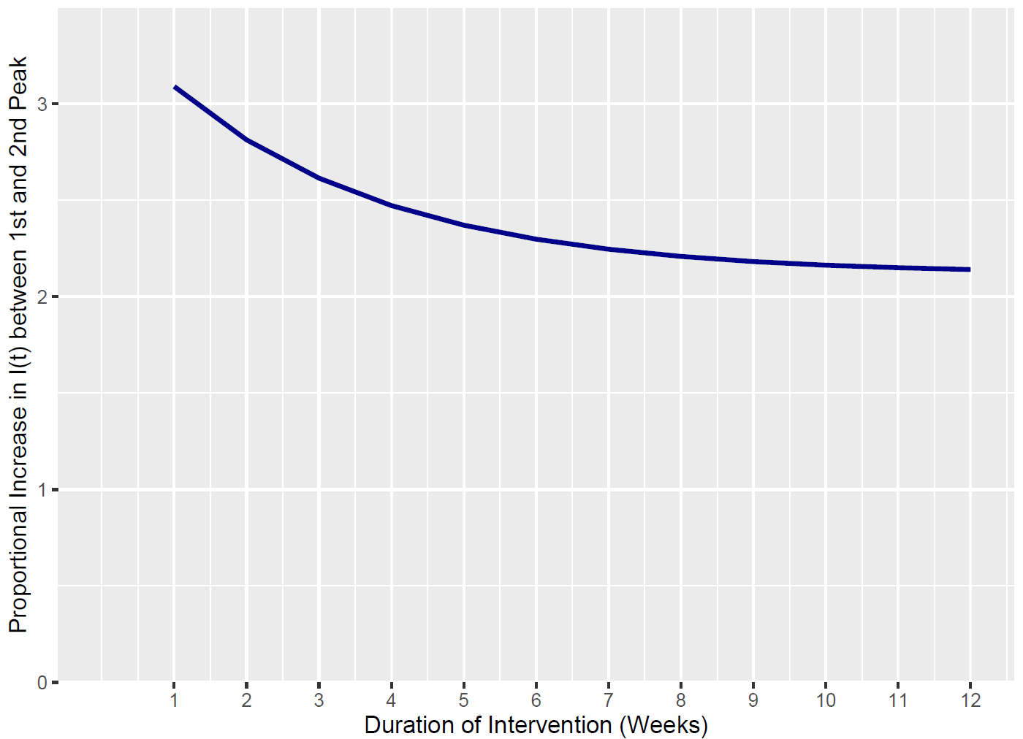
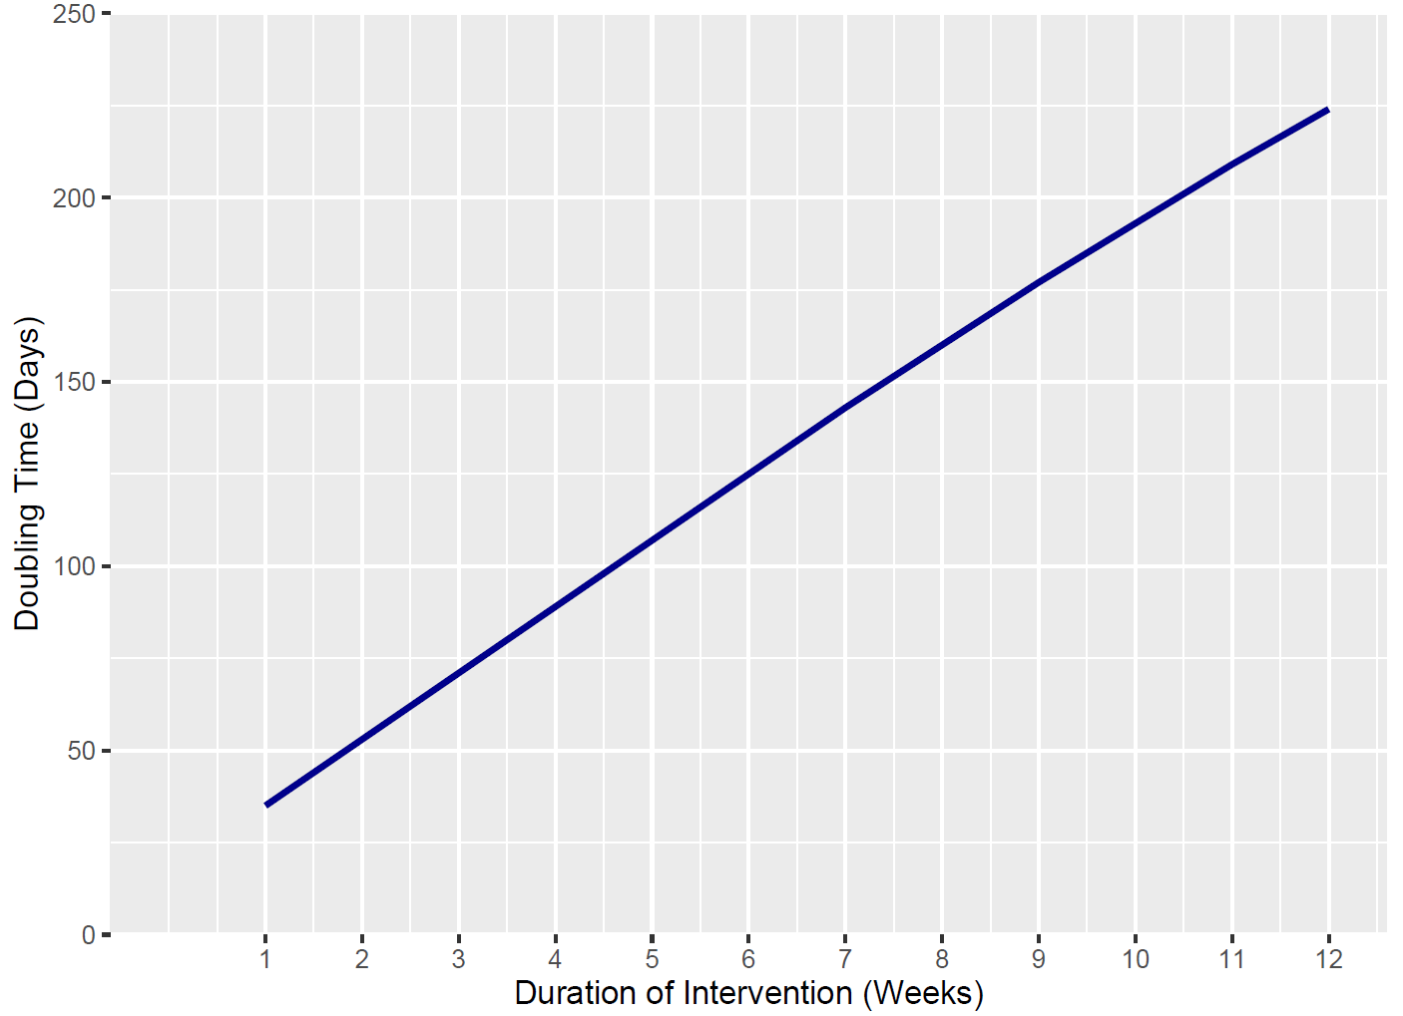
Doubling Time is calculated as the time between I(t) at the 1st Peak and when I(t) is double its value from the 1st Peak
Intervention Duration | I(t) First Peak | I(t) Second Peak | Relative Increase Between Peaks | Days Between Peaks | Doubling Time
1 Week | 0.0182 | 0.056 | 3.091 | 64 | 35
2 Weeks | 0.0182 | 0.051 | 2.814 | 80 | 53
3 Weeks | 0.0182 | 0.047 | 2.615 | 96 | 71
4 Weeks | 0.0182 | 0.045 | 2.473 | 112 | 89
5 Weeks | 0.0182 | 0.043 | 2.371 | 128 | 107
6 Weeks | 0.0182 | 0.042 | 2.298 | 144 | 125
7 Weeks | 0.0182 | 0.041 | 2.246 | 160 | 143
8 Weeks | 0.0182 | 0.040 | 2.209 | 176 | 160
9 Weeks | 0.0182 | 0.040 | 2.182 | 192 | 177
10 Weeks | 0.0182 | 0.039 | 2.164 | 207 | 193
11 Weeks | 0.0182 | 0.039 | 2.151 | 222 | 209
12 Weeks (Baseline) | 0.0182 | 0.039 | 2.141 | 237 | 224

Slide 4
SIS Model – With Day 100 Trigger

Slide 5
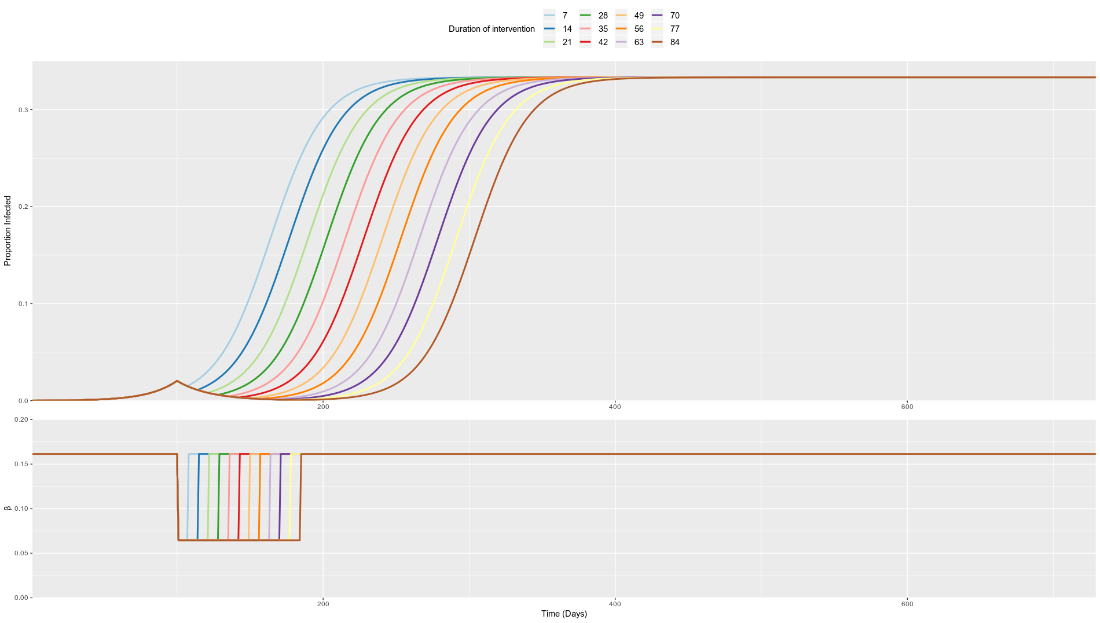
Time of Intervention Trigger =
100 Days (Week ~14.2)
Optimised timing for the two 12 week intervention scenario
I(t = 100) = 0.0204

Slide 6
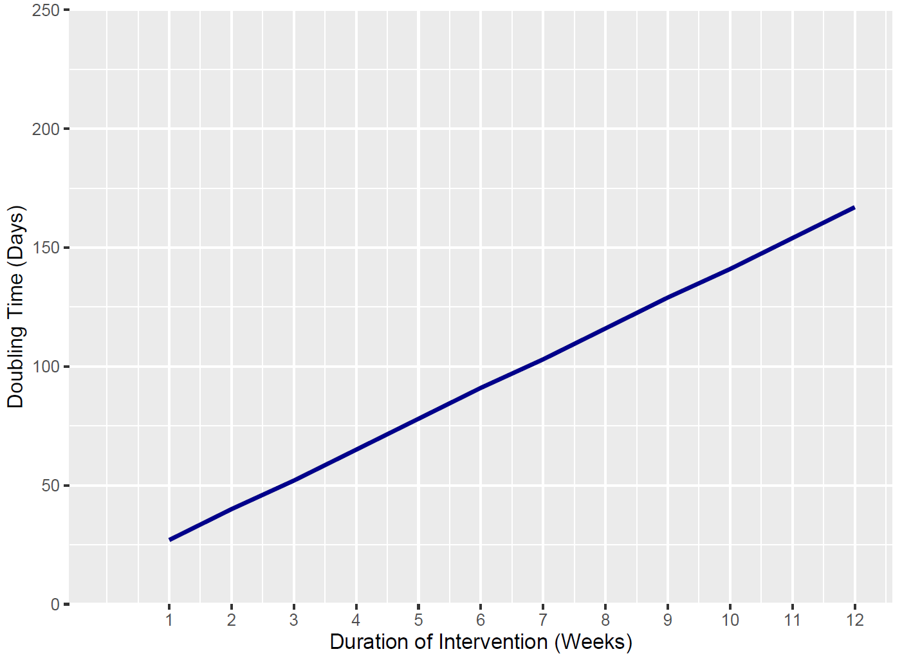
Doubling Time is calculated as the time between I(t) at the 1st Peak and when I(t) is double its value from the 1st Peak
Intervention Duration | I(t) First Peak | I(t) Second Peak | Relative Increase Between Peaks | Days Between Peaks | Doubling Time
1 Week | 0.0204 | 0.3333 | 16.33 | 127 | 27
2 Weeks | 0.0204 | 0.3333 | 16.33 | 140 | 40
3 Weeks | 0.0204 | 0.3333 | 16.33 | 152 | 52
4 Weeks | 0.0204 | 0.3333 | 16.33 | 165 | 65
5 Weeks | 0.0204 | 0.3333 | 16.33 | 178 | 78
6 Weeks | 0.0204 | 0.3333 | 16.33 | 191 | 91
7 Weeks | 0.0204 | 0.3333 | 16.33 | 203 | 103
8 Weeks | 0.0204 | 0.3333 | 16.33 | 216 | 116
9 Weeks | 0.0204 | 0.3333 | 16.33 | 229 | 129
10 Weeks | 0.0204 | 0.3333 | 16.33 | 241 | 141
11 Weeks | 0.0204 | 0.3333 | 16.33 | 254 | 154
12 Weeks (Baseline) | 0.0204 | 0.3333 | 16.33 | 267 | 167

